Slide 1
Clash Of Kings
Team - Five Stars
Satish Kumar Gollaprolu
Akansha Mehta
Shiva Kumar Padma
Venkata Deviprasad Sura
Swetha Kothari

Slide 2
Game Idea
Clash of kings is an unique of its kind web based multiplayer strategy game with at most 4 users playing the game. The primary motive of the players is to kill opponents and last one who survives will be declared winner.
Game Rules:
Each player should join the game by providing his name and submitting it
Based on the availability of existing game room’s a player can either join an existing game or start a new game
Game will begin once all the 4 players join the game room

Slide 3
Game Rules
Chess board will have 4 kings for all the players with white(player1) Black(player2) Red(player3) and yellow(player4) colors
Chess board will also have multi-colored static pieces which are randomly arranged on the board with different powers
Static piece can be either Queen, Rook, Bishop, Knight or Pawn
If a player kills a static piece he will become that power which static piece possessed
Each player will be halted in their squares for 5 seconds after every move

Slide 4
Game Rules
A player can only kill other players with in 5sec after their previous move
Players can use the chat to form strategies or target a player
If a player forfeits the game will continue with remaining players(if total players>=2)
Player will exit the game if he gets killed by other players
Game will be declared as a tie after 20 moves if only 2 players remain and cannot kill other

Slide 5
Technologies Used
Node.js
Express
Socket.io

Slide 6
User Story
Story:
In order to win the Clash of Kings game
As a player
I want to kill other players in the board.
Scenario 1: Player remains last in the game by killing other players in the game.
Given: The chess game for 4 players is launched
And: player starts playing the game.
When: player kills all the other players in the board.
Then: player wins the game.

Slide 7
User Story
Story:
In order to gain new powers in game
As a player
I want to kill static players in the board.
Scenario 1: Player kills the static player in the game to its powers.
Given: The chess game started with 4 players .
And: player starts playing the game.
When: player kills all the static piece in the board.
Then: player should get the same power of the static piece killed.

Slide 8
User Story
Story
In order to devise a strategy to kill other players
As a player
I want to chat with other players in the board.
Scenario 1: player should be able to chat with other players to decide whom to attack.
Given: All the players joined in game
When: a player sends a message in chat box.
Then: other players should see the message in the chat.
More scenarios can be found at : https://drive.google.com/file/d/1ylHDZkz5cVKe1I5Wii6eni7t64vhI43q/view?usp=sharing

Slide 9
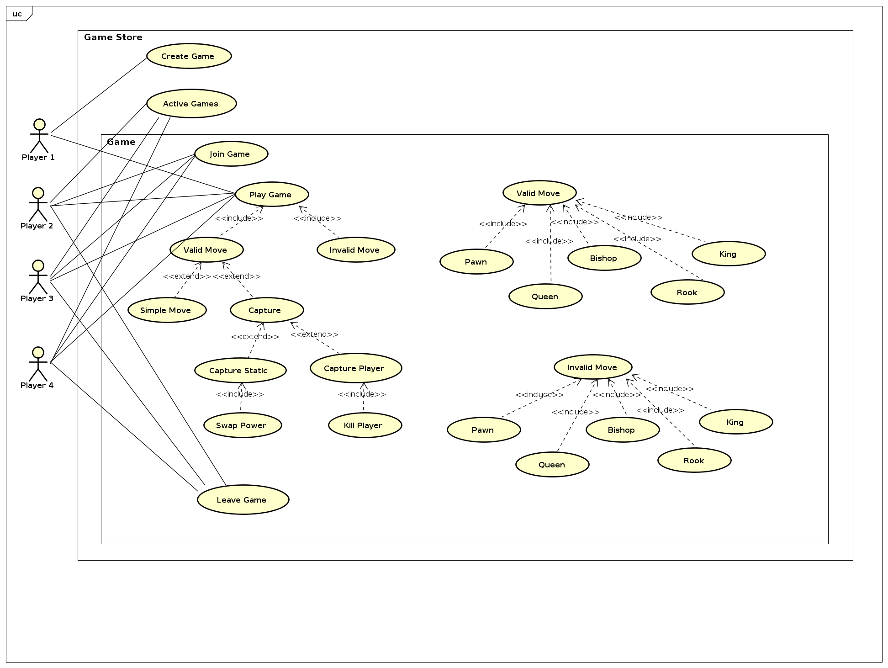
Use Case Diagram

Slide 10
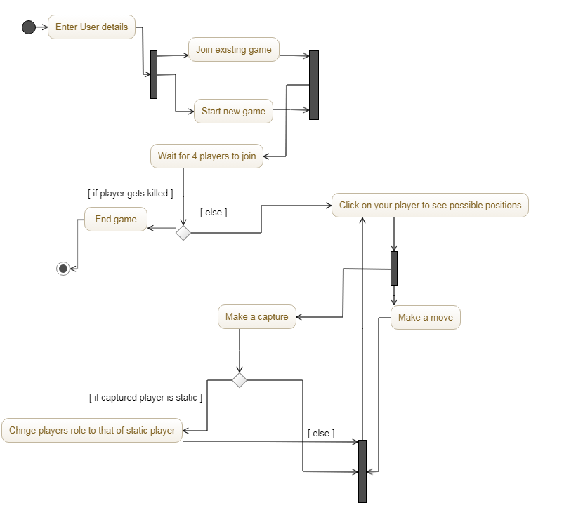
Activity Diagram

Slide 11
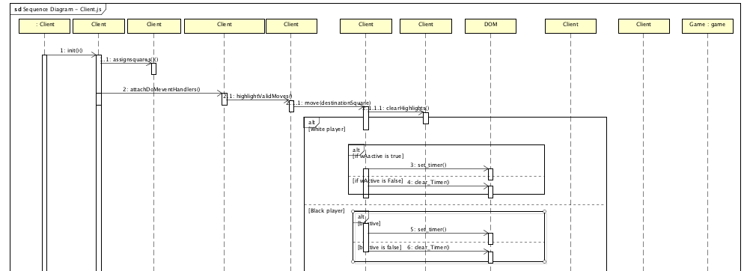
Sequence Diagram

Slide 12
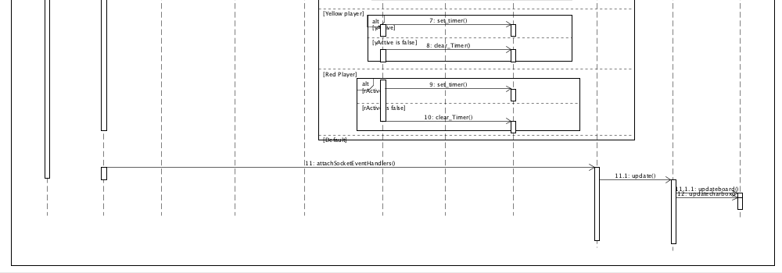
Sequence Diagram contd..

Slide 13
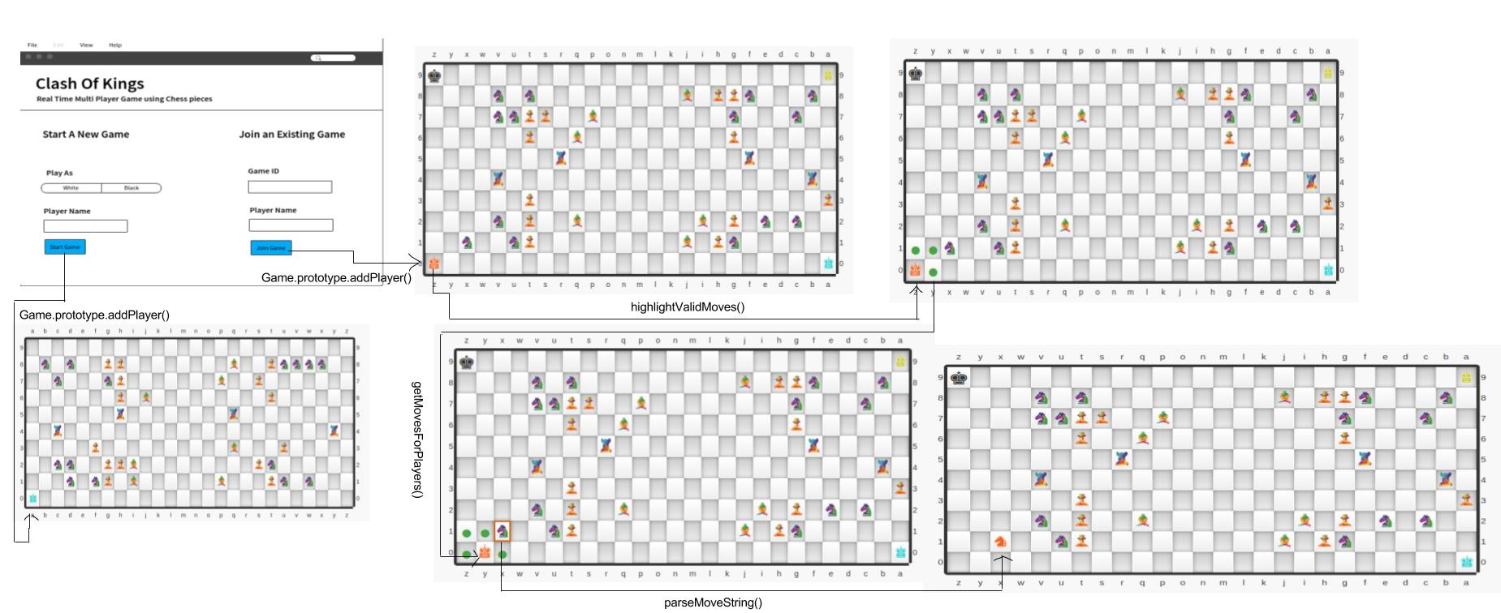
UI Wireframe Diagram

Slide 14

Design Patterns
Strategy:
getMovesForPlayer
<<interface>>
PlayerMoves
+playerMoves:PlayerMoves
Containment
+setStrategy()
+getMoves()
<<implements>>
Pawn
Rook
Knight
Bishop
Queen
King
+getMoves()
+getMoves()
+getMoves()
+getMoves()
+getMoves()
+getMoves()

Slide 15

Design Patterns
Observer:
Subject
<<interface>>
Observer
<<interface>>
+update()
notifies
+subscribe(in o: Observer)
+unsubscribe(in o: Observer)
+notify()
Player
Score
-player
- score
+update()

Slide 16
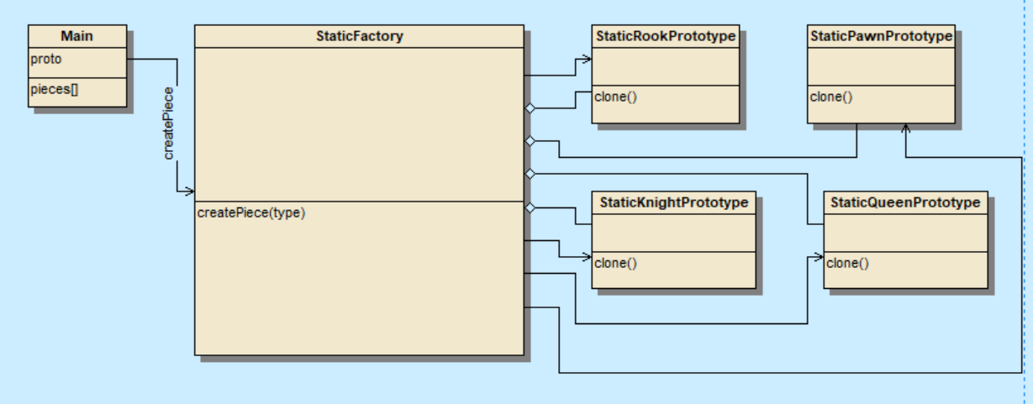
Design Patterns
Factory/Prototype:

Slide 17
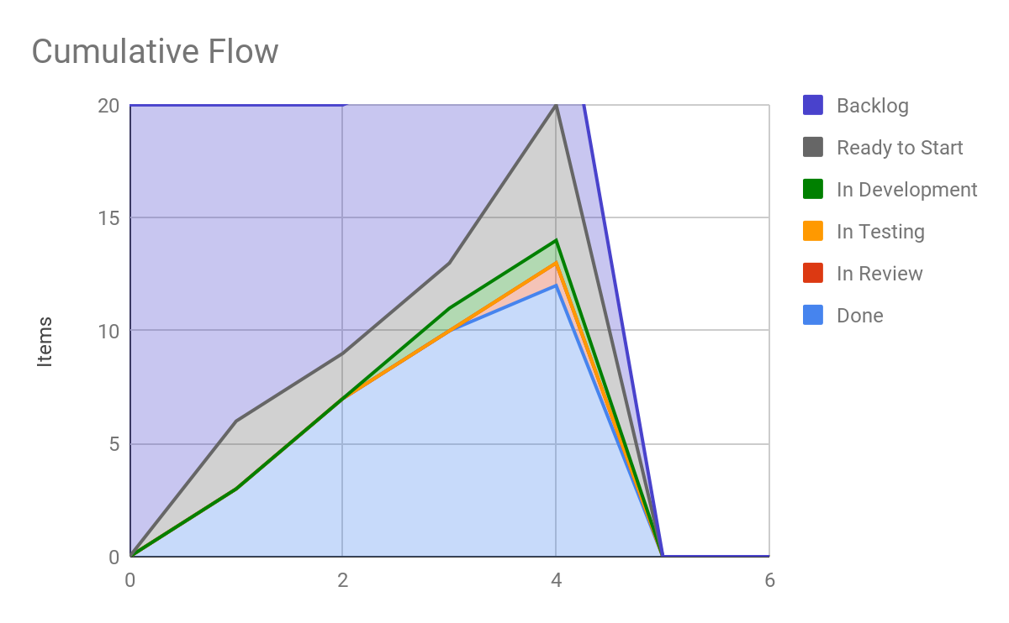
Cumulative Flow Diagram
https://docs.google.com/spreadsheets/d/150TyqCxRxhK7aqt2JpKUFNBQsHHqq0wVjuAcBEJsWQM/edit?zx=2jqdbu5wz2x1#gid=2
Notes:
Cumulative flow Diagram
https://docs.google.com/spreadsheets/d/150TyqCxRxhK7aqt2JpKUFNBQsHHqq0wVjuAcBEJsWQM/edit?zx=2jqdbu5wz2x1#gid=2

Slide 18
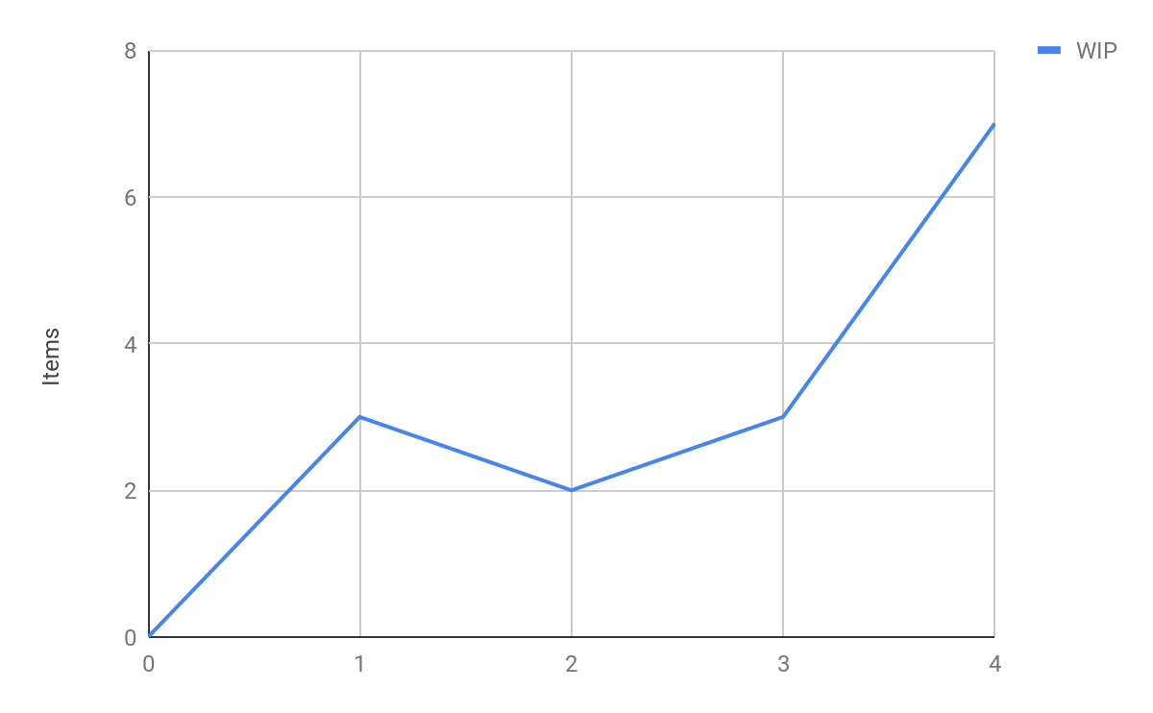
Work In Progress

Slide 19
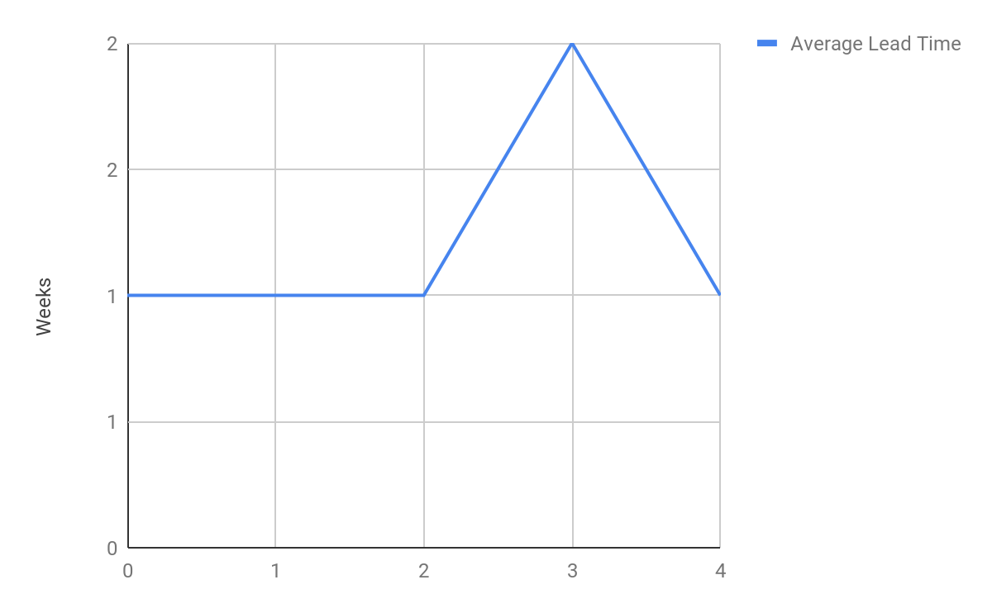
Average Lead Time

Slide 20
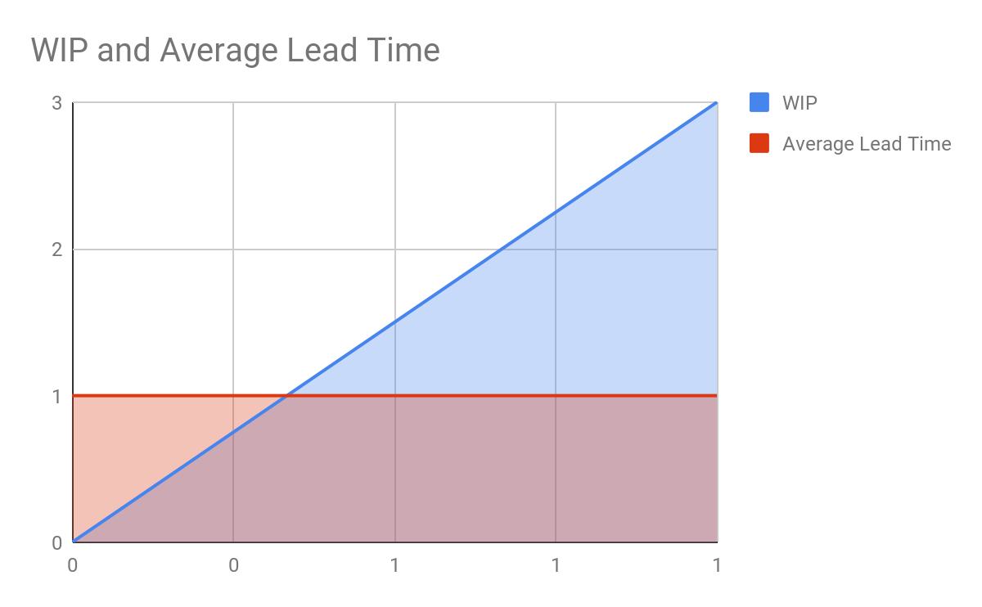
WIP and Average Lead Time

Slide 21
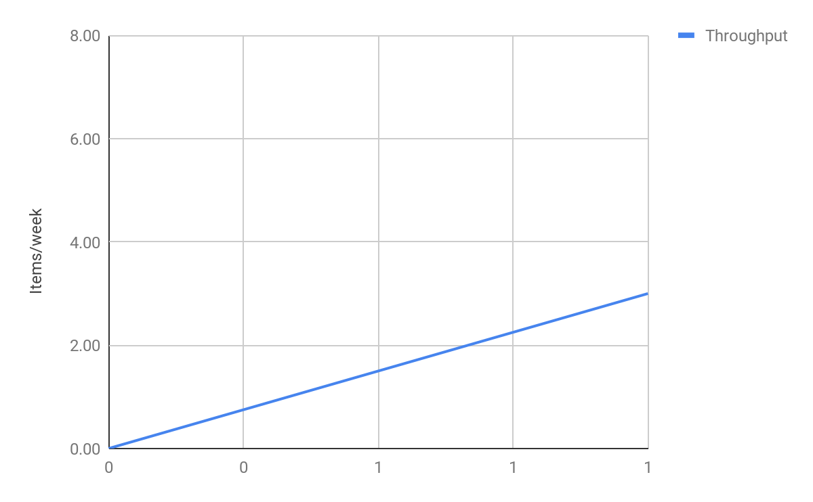
Throughput

Slide 22
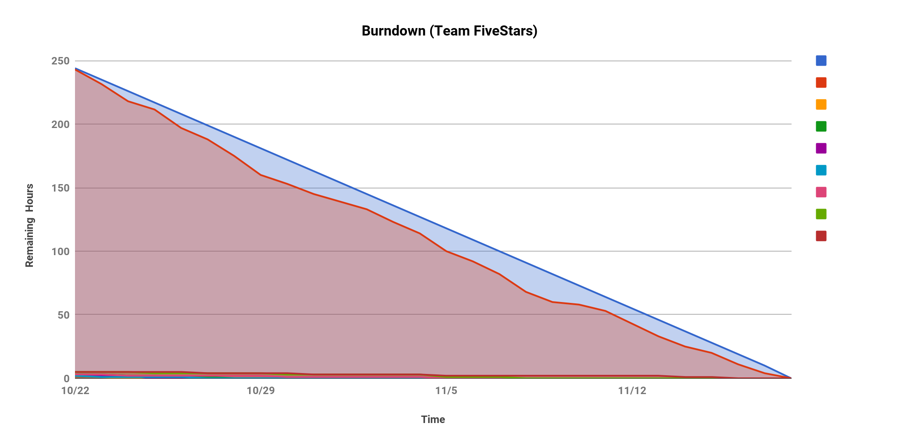
Burndown Chart
https://docs.google.com/spreadsheets/d/1JCwrrKYYLpR_GcMBCLl4FsvvsWJpbuLkF6Eb9Omjt1k/edit#gid=879809152

Slide 23
Retrospective
What went well? | What didn’t go well and can be improved? | What we learned?
Every team member contributed actively in finalizing the game idea and designing rules to make the chess game interesting. | Code development for highlighting player moves, capturing/killing players was challenging and took more efforts and time than other modules. | We learned Agile Methodologies(XP, Kanban, Scrum), UML Diagrams, types of game engines and the cases where they can be used effectively.
The use of Node.js and express framework to create the game improved the simplicity of the project components. | TDD and BDD should be implemented from the 2nd week of development to find the issues at early stages. | Design patterns in java script and how they are implemented when compared to traditional object-oriented programming languages.
Multiplayer interaction and chat box got implemented in a better way using socket.io library. | Randomization algorithm for static players can be improved to provide equal chance for all the players. | How to split the work between the team in order to improve the productivity and co-ordinate with others in case of issues and road blocks.
Each team member maintained the commit history and code version well | Our initial time estimation on design patterns went wrong. It took more time to be implemented as we are new to Javascript. | Respect other team members opinions and make decisions after others approval upon discussion.
Team Bonding. Each team member respected the feedback from other team members and worked on it. | Chess board UI and chess pieces look can be improved by efficient use of HTML and CSS. | Stop anything that blocks the team from moving forward.

Slide 24
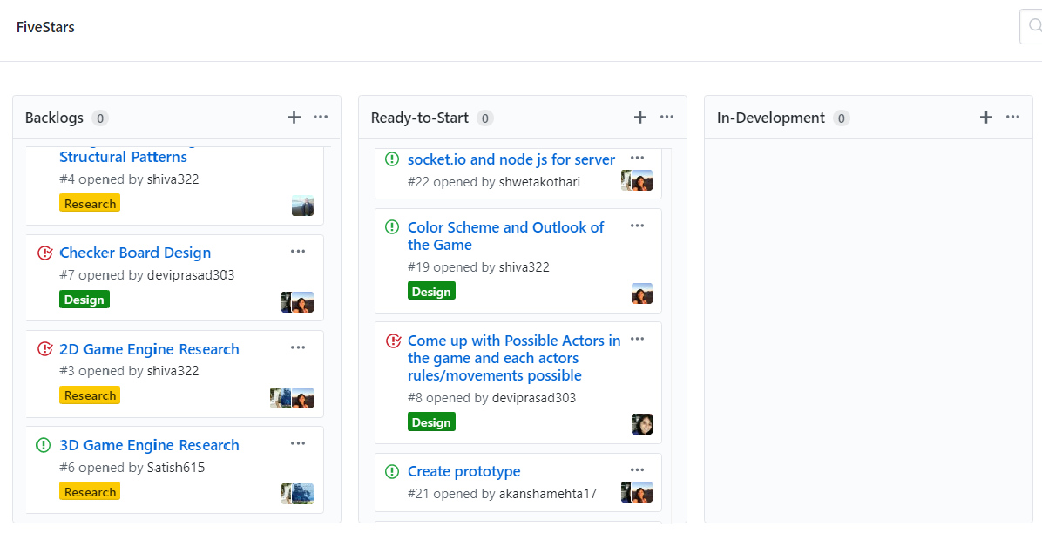
Taskboard
https://github.com/nguyensjsu/cmpe202-fivestars/projects/1

Slide 25
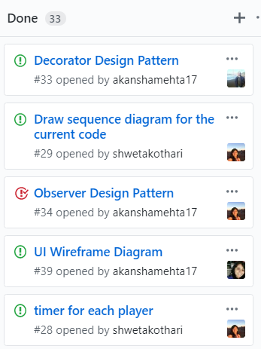
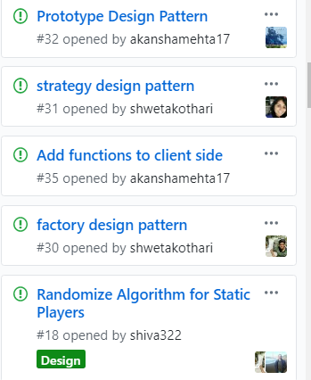
Taskboard

Slide 26
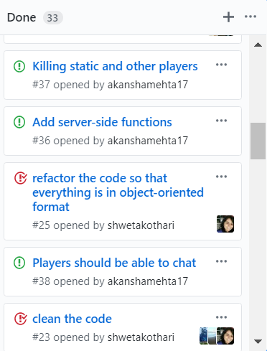
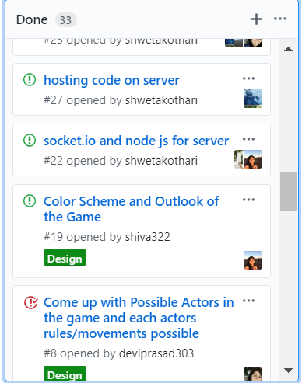
Taskboard

Slide 27
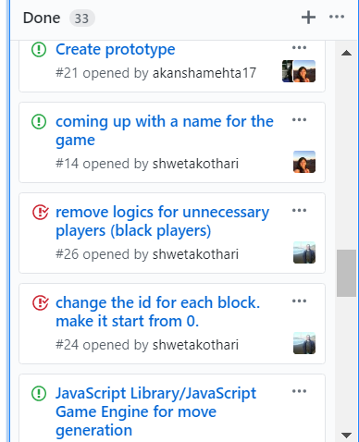
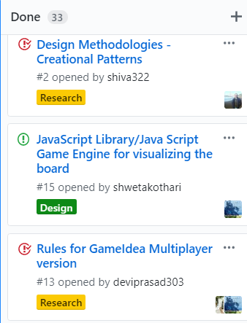
Taskboard

Slide 28
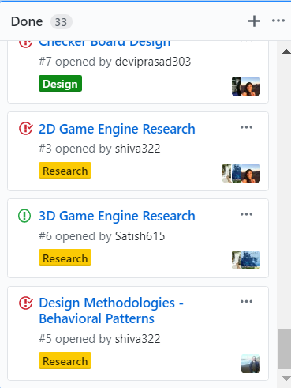
Taskboard

Slide 29
Thank You!

